Slide 1
Appendix E
The Intel IA-32 Architecture

Slide 2
Appendix Outline
Memory organization and register structure
Addressing modes and types of instructions
Input/output capability
Scalar floating-point operations
Multimedia operations
Vector floating-point operations

Slide 3
Memory Organization
Byte-addressable, 32-bit address space
Little-endian addressing scheme
Double-word (32-bit) and byte (8-bit) data
are most common types
Also have quadword (64-bit) and word (16-bit)
Multiple-byte operands may start at any
byte address location; alignment not required

Slide 4
Register Structure
Eight 32-bit regs., some of which are special:
EAX, EBX, ECX, EDX, EBP, ESP, ESI, EDI
EAX to EDX also have 8- and 16-bit subparts, e.g., AX (lowest 16), AL (lowest 8), AH (next 8)
EIP (instruction pointer), EFLAGS (status reg.)
EFLAGS condition code flags: ZF, SF, CF, OF
6 segment registers for segmented memory; set to 0 when using simple flat memory model

Slide 5
Addressing Modes
Immediate: signed 8/32-bit number
Direct: 32-bit memory address
Register: one of the 8 general-purpose regs.
Register indirect: 32-bit address in a register
Base with displacement: [reg] + 8/32-bit value
Index with displacement:
32-bit value + (1, 2, 4, or 8) * [reg]
Base with index: [reg1] + (1, 2, 4, or 8) * [reg2]
Base with index and displacement:
8/32-bit value + [reg1] + (1, 2, 4, or 8) * [reg2]

Slide 6
Instructions
Zero, one, or two operands
Two-operand format: OP dst, src
Two memory operands not permitted
Move instructions to show addressing modes:
MOV EAX, 25
MOV EAX, DWORD PTR LOCATION
MOV EBX, OFFSET LOCATION
MOV AL, [EBP + 10]
MOV EAX, [EBP + ESI * 4 + 200]

Slide 7
Machine Instruction Format
1 to 12 bytes in length, with up to 4 fields
OP-code field uses 1 or 2 bytes (most use 1)
Addressing mode info in next 1 or 2 bytes
Next 1 to 4 bytes for any displacement
Final 1 to 4 bytes for any immediate value
Simplest instructions need only one byte, e.g.,
INC EDI
OP-code byte has 3 bits to name a register

Slide 8
Assembly-Language Notation
Register operand usually indicates data size
Keywords DWORD PTR or BYTE PTR necessary
(a) to indicate desired data size if no register
(b) to specify treatment of a label as a pointer
Keyword OFFSET used to specify treatment of a label as an immediate value
For consistency with Intel documentation, upper-case characters used for instructions

Slide 9
Move Instruction
Transfers data: memory or I/O ↔ registers
Condition code flags not affected by transfer
Previous examples transferred mem. → reg.
Can transfer reg. → mem. and reg. → reg.
MOV LOCATION, ECX
MOV EBP, EDI
Can also transfer immediate value → mem.
MOV DWORD PTR [EAX + 16], 100

Slide 10
Arithmetic Instructions
Operands: in memory, in register, immediate
ADD, ADC (with carry), SUB, SBB (with borrow)
CMP (subtract without modifying destination)
Condition codes affected by result
Single-operand operations: INC, DEC, NEG
Carry flag not affected by INC and DEC
Must specify data size if sole operand is a label

Slide 11
Arithmetic Instructions
Signed 32-bit multiplication with IMUL
In one version, EAX implicitly is multiplicand, and source operand is multiplier:
IMUL src
64-bit product is placed in {EDX (hi), EDX (lo)}
Another version puts 32-bit result in register:
IMUL REG, src
Only carry/overflow flags affected by result

Slide 12
Arithmetic Instructions
Signed division with IDIV instruction:
IDIV src
64-bit dividend in {EDX,EAX} divided by source
Quotient placed in EAX, remainder in EDX
Condition code flags are undefined
Use CDQ (convert doubleword to quadword) to sign-extend 32-value in EAX to fill EDX
before executing IDIV

Slide 13
Jump and Loop Instructions
All branches, whether conditional or not,
are called Jumps in IA-32 architecture
There is also a special Loop instruction
Conditional Jumps test condition code flags with signed or unsigned interpretations
Instructions for ‘greater-than’ condition:
signed Jump-greater (JG) tests ZF, SF, and OF
unsigned Jump-above (JA) tests ZF and SF only

Slide 14
Jump and Loop Instructions
Unconditional Jump (JMP); when used with Index addressing, enables use of jump tables
Loop instruction combines register decrement with greater-than test to branch; uses ECX
Example:
MOV ECX, NUM_PASSES
START: ...
LOOP START

Slide 15
Logic, Shift, and Rotate Instructions
2-operand AND, OR, XOR; 1-operand NOT
Amount for shift or rotate given in 8 bits
Specified as immediate value or in reg. CL
Logical shift SHL, SHR
Arithmetic shift SAL, SAR (SAL same as SHL)
Rotate without carry flag ROL, ROR
Rotate with carry flag RCL, RCR

Slide 16
Subroutine Linkage Instructions
ESP is pointer to stack; growth is downward
All entries on stack must be doublewords
PUSH / POP instructions for single entries
PUSHAD / POPAD save/restore all registers (saved ESP value discarded when restoring)
CALL instruction saves return address on stack
RET instruction pops return address to EIP

Slide 17
Assembler Directives
Popular form of IA-32 assembly language uses directives for Microsoft MASM assembler
.CODE or .DATA define start of segment
DD directive defines storage for doublewords
DB directive defines storage for bytes
EQU directive defines symbolic constant

Slide 18
Example Programs
Vector dot product performs multiplication and addition operations for array elements
String search uses nested loops to
match given pattern in target string

Slide 19
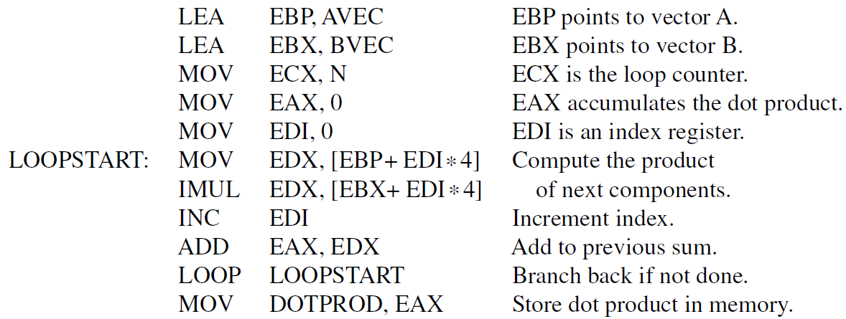

Slide 20
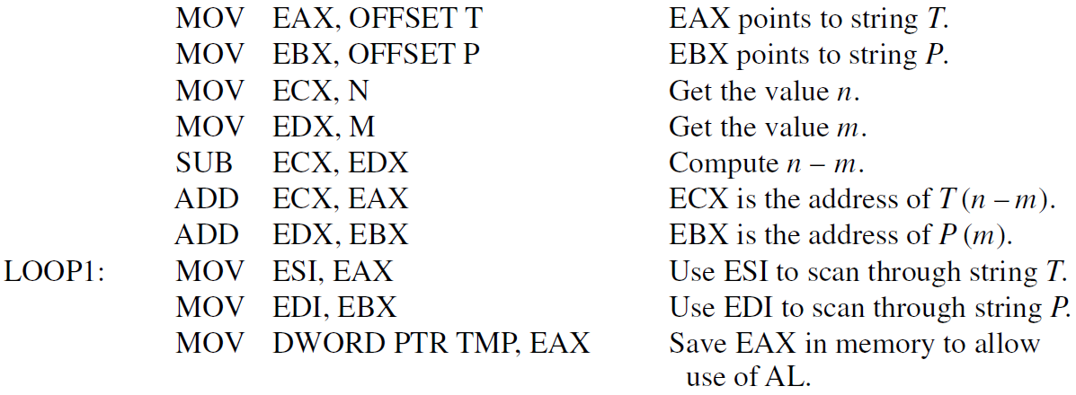

Slide 21
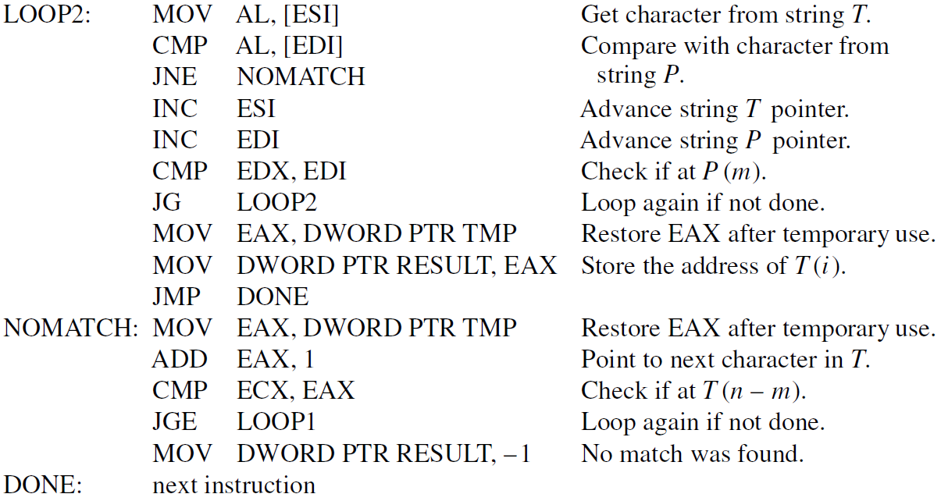

Slide 22
Scalar Floating-Point Operations
FPU has eight registers, each 80 bits in size
Treated as a stack; top ST(0) to bottom ST(7)
Data transfer and arithmetic operations using FP registers also do push and pop operations
Pointer to stack wraps around as needed
FLD pushes memory FP operand to new ST(0)
FST writes ST(0) to memory; FSTP also pops
FILD/FIST/FISTP for integers with conversion

Slide 23
Scalar Floating-Point Operations
FP operands can be single- or double-precision
Use DWORD PTR or QWORD PTR to specify when performing data transfers to/from mem.
FADD, FSUB, FMUL, FDIV have 1 or 2 operands
Single source operand is in memory, and destination is implicitly ST(0)
Two operands must be registers,
with ST(0) as either source or destination

Slide 24
Multimedia Operations
The multimedia extension (MMX) instructions operate on multiple integers simultaneously
Elements are packed into a 64-bit quadword:
8 bytes, 4 words, 2 doublewords, 1 quadword
Registers MMX0-MMX7 are scalar FP registers; only 64 bits each and not managed as a stack
Example instructions (B suffix means 8 bytes) :
MOVQ MM2, [EAX] Transfer from mem.
PADDB MM2, [EBX] Add with mem. data

Slide 25
Vector Floating-Point Operations
Streaming SIMD extension (SSE) instructions use dedicated 128-bit registers XMM0-XMM7
Each holds four 32-bit floating-point elements
MOVAPS/MOVUPS instructions for transfers to/from memory for aligned/unaligned data
Arithmetic on regs. & mem.; dest. always reg.
To perform four FP additions simultaneously:
ADDPS XMM0, XMM1
Other operations: SUBPS, MULPS, and DIVPS

